Slide 1
Connection Saves Lives
A School-Based Approach to Suicide Prevention
Michelle Knight, MHA & MBA
Suicide Prevention Specialist
Notes:
Welcome participants. Connection is a practical suicide prevention strategy schools can build into systems, relationships, routines, and response protocols.

Slide 2

Today’s Promise
By the end, participants will be able to:
Recognize warning signs and risk factors
Name protective factors schools can strengthen
Connect legal requirements to daily practice
Identify funding streams and resources to support implementation

Slide 3
Safety Note
This session supports prevention awareness and school practice. It does not replace local protocols, clinical judgment, crisis assessment procedures, or emergency response. Follow LEA policies and contact SafeUT, 988, or emergency services for immediate crisis needs.​
Notes:
Set norms for sensitive content. Encourage participants to care for themselves and step away if needed. Remind everyone to use local crisis response protocols and the 988 Suicide and Crisis Lifeline for immediate crisis support.

Slide 4
September: Awareness into Action
Use Suicide Prevention Month to build habits that last beyond September.​
Normalize help-seeking and reduce stigma​
Practice asking, listening, connecting, and following up​
Lift student voice and belonging​
Refresh staff protocols and resource pathways​
Notes:
Suicide Prevention Month gives schools a visible reason to talk about mental health, but the goal is to turn awareness into ongoing practice. Encourage schools to choose one or two sustained connection habits rather than a one-time activity

Slide 5

September: Awareness into Action (2)
Keep it safe and strengths-based:​
Use hopeful, action-oriented messaging​
Avoid sensational details or unsafe portrayals​
Pair awareness with concrete help options​
Center connection, belonging, and trusted adults​
Notes:
Suicide Prevention Month gives schools a visible reason to talk about mental health, but the goal is to turn awareness into ongoing practice. Encourage schools to choose one or two sustained connection habits rather than a one-time activity

Slide 6

Risk Factors are not Warning Signs
Risk Factors
Increase vulnerability over time​
May exist at individual, relationship, community, or societal levels​
Help guide prevention planning and resource allocation​
Examples: isolation, prior attempt, bullying, substance use, access to lethal means​
Notes:
Clarify the difference. Both matter, but they tell us different things.​ Risk factors can help us identify where to build protective factors. Warning signs mean we act. The response should be supportive, calm, direct, and consistent with local procedures.
Use risk factors for prevention planning. Use warning signs for immediate connection and response.​

Slide 7

Warning Signs
Indicate possible immediate or near-term risk​
Require timely response according to LEA protocol​
Often include changes in talk, mood, behavior, or withdrawal​
Examples: talking about wanting to die, hopelessness, giving away possessions​
Notes:
Clarify the difference. Both matter, but they tell us different things.​ Risk factors can help us identify where to build protective factors. Warning signs mean we act. The response should be supportive, calm, direct, and consistent with local procedures.
Use risk factors for prevention planning. Use warning signs for immediate connection and response.​

Slide 8
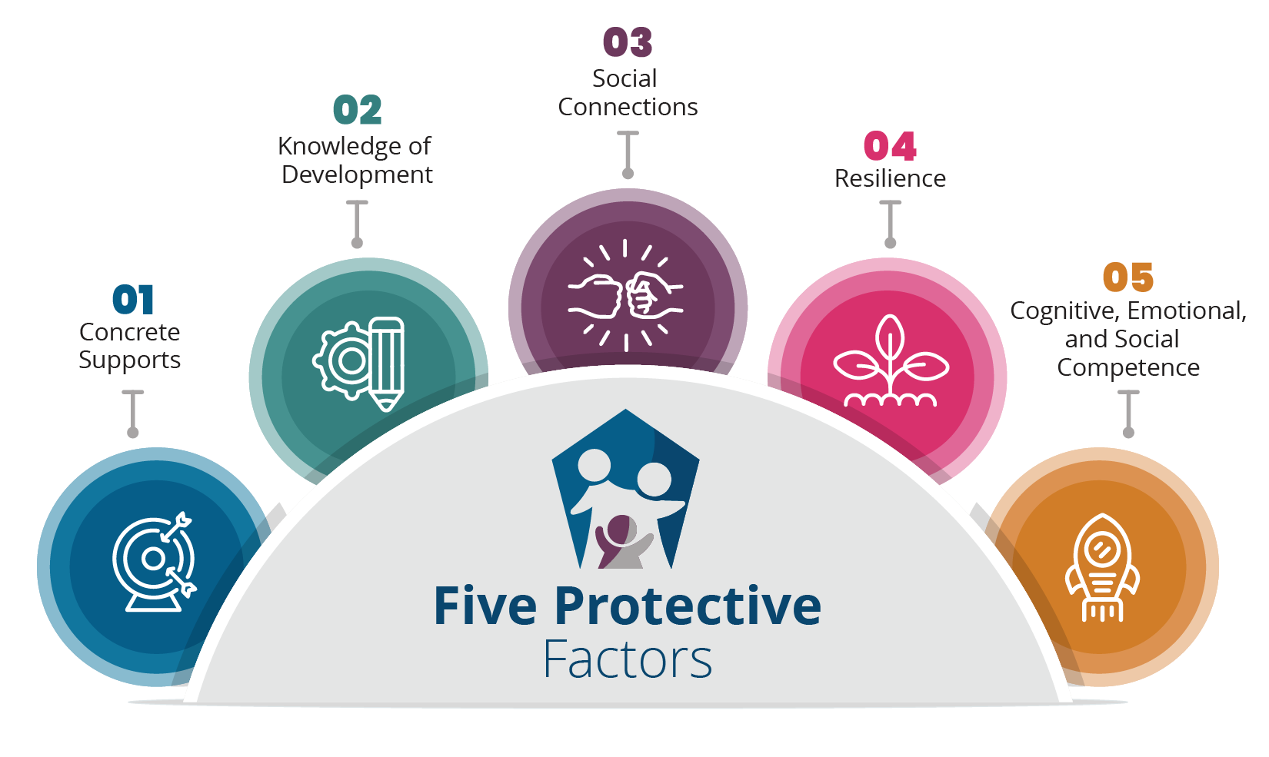
Protective Factors Framework
Notes:
The PF approach guides the work: helps us make decisions about WHAT we need to work on with students and help us explain WHY, as well as HOW we should go about the work.
It is NOT a new model, program, or intervention.
Can be easily integrated into existing approaches to enhance the work, make us more effective and provide a greater impact

Slide 9

Prevention is strongest when protective factors are
built before crisis.​
Notes:
Schools are not expected to control every risk factor, but schools can intentionally build protective factors at multiple levels

Slide 10


Protective Factor Framework (2)
Individual
Coping and problem-solving skills, reasons for living, and cultural identity.​
Relationships
Support from friends, family, trusted adults, and positive peers.​
Notes:
Schools are not expected to control every risk factor, but schools can intentionally build protective factors at multiple levels

Slide 11

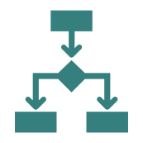
Protective Factor Framework (3)
Schools and Community
Connectedness to school, community, social institutions, and high-quality care.​
Systems
Reduced access to lethal means, safe environments, clear protocols, and resource pathways.​
Notes:
Schools are not expected to control every risk factor, but schools can intentionally build protective factors at multiple levels

Slide 12


Best Practices
Belonging Checks
Use short routines to notice who is missing, disconnected, or withdrawing.
Trusted Adult Mapping
Identify whether each students can name at least one adult they would go to for help.
Notes:
Schools are not expected to control every risk factor, but schools can intentionally build protective factors at multiple levels

Slide 13


Best Practices (2)
Warm Handoffs
Move students from concern to support with dignity and clarity
Family-Inclusive Plans
Communicate early, clearly, and with resources that families can use.
Notes:
: Invite participants to choose one best practice that could be started or strengthened within two weeks. Keep the action concrete and small enough to implement

Slide 14


Best Practices (3)
Lethal Means Safety
Provide materials and practical information when required or appropriate.
Post-crisis Connection
Plan re-entry, check-ins, academic flexibility, and staff coordination.
Notes:
: Invite participants to choose one best practice that could be started or strengthened within two weeks. Keep the action concrete and small enough to implement v

Slide 15

Connectedness is Suicide Prevention
Students are more likely to seek help when they believe they matter, belong, and are known by trusted adults.
Notes:
Transition from individual response to school climate. Schools can intentionally design belonging through routines, adult-student relationships, peer connection, family engagement, and easy access to support.

Slide 16

Belonging is a System Outcome
Connection becomes prevention when it is intentional, repeated, and visible
Notes:
Ask participants to think of one student population in their school that may experience weaker connection. What routine or system could be adjusted so those students are more likely to be noticed and supported?

Slide 17
Belonging is a System Outcome (2)
Every student is known: name, needs, strengths, and one trusted adult
Every family is engaged: clear pathways to ask questions, request help, understand resources
Every day routines: warm welcomes, check-ins, restorative conversations, inclusive activities
Every transition supported: return-to-learn plans, re-entry check-ins, post-crisis support
Notes:
Ask participants to think of one student population in their school that may experience weaker connection. What routine or system could be adjusted so those students are more likely to be noticed and supported?

Slide 18
School-based Prevention System
Universal Prevention
Targeted Support
Protective factors, climate, belonging, skill-building, help-seeking
Parent/community messaging and resources
Staff awareness and protocol refreshers
Early identification and student support teams
Mental health screening pathways when approved
and consented
Referral, follow-up, and family connections
Notes:
Help participants locate their existing work. Suicide prevention is not one program; it is a connected system that includes universal protective factors, targeted supports, crisis response, and postvention.

Slide 19

Crisis Response and Postvention
Immediate safety response and parent notifications
Return-to-learn and continued supports, as needed
Postvention for students, staff, and families
Notes:
Help participants locate their existing work. Suicide prevention is not one program; it is a connected system that includes universal protective factors, targeted supports, crisis response, and postvention.

Slide 20
When Concern Shows Up…
Step 1: Connect
Move toward the student with calm, privacy, and care.
Step 2: Ask
Ask directly and compassionately about safety concerns according to training and LEA protocols.
Notes:
This is a high-level response flow, not a replacement for local risk assessment or clinical protocols. Emphasize that direct, compassionate questions can be appropriate when a school employee believes a student may be at risk, and that schools should follow required parental notification and emergency protocols.

Slide 21
When Concern Shows Up… (2)
Step 3: Stay
Do not leave a student with imminent concern alone.
Step 4: Link
Connect to parent/guardians, school team, SafeUT/988, MCOT, or emergency services.
Notes:
If there is immediate danger: follow LEA emergency protocol and contact crisis/emergency supports immediately.​

Slide 22
Requirement Refresh
Use the law as a structure for prevention, not just compliance
Youth Suicide Prevention Program
Districts and charter schools implement youth suicide prevention programs addressing life-affirming education, relationships, family strengthening, prevention, intervention, and postvention.
R277-620 requires LEAs to implement appropriate youth suicide prevention programs, establish parent-notification policies, and provide reporting information for required Board reporting.
Notes:
Emphasize that Utah requirements align directly with protective factor work. The requirement to address resiliency, relationships, family strengthening, and postvention can become a practical prevention planning checklist

Slide 23

Licensed Employee Training
School districts and charter schools require licensed employees to complete professional development training on youth suicide prevention every three years.
USBE Canvas course is available.
Notes:
Emphasize that Utah requirements align directly with protective factor work. The requirement to address resiliency, relationships, family strengthening, and postvention can become a practical prevention planning checklist

Slide 24
Student risk
When a student
threatens suicide
When a student may
be at risk
The student has made a threat or expressed suicidal intent.
There is concern about suicidal thoughts,
self-harm, or harm to others.
Ask questions when there is concern about suicidal thoughts, self-harm, or harm to others.
Refer the student to prevention services and inform the parent.
Maintain records consistent with privacy and data protection requirements.
Notify the parent.
Maintain a record verifying parent notification.
Share suicide prevention materials.
Provide information on limiting access to fatal means.
Notes:
This slide is meant to reduce confusion and repeated questions from the field. Remind participants to use local policy and consult their legal/administrative support for implementation details.

Slide 25
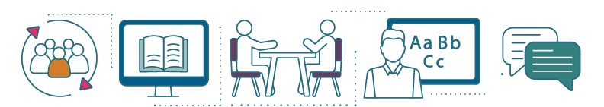
Funding Opportunity
Resources help schools move from intent to implementation.
Notes:
Transition to prevention updates.

Slide 26
Grants
Screening Grant
Available for participating LEAs
Supports approved school-based mental health screening and related follow-up pathways, including qualifying parent reimbursement when criteria are met.
Notes:
Invite participants to think about which funding stream best supports their next protective factor priority

Slide 27
Grants (2)
Prevention Block Grant
Supports comprehensive prevention plans, Tier 1 and Tier 2 prevention activities including data-informed needs, parent seminars, evidence-based practices, professional learning, and implementation materials.
Notes:
Invite participants to think about which funding stream best supports their next protective factor priority

Slide 28
Suicide Prevention Funding
Direct flow-through
Supports school-level implementation of evidence-based practices, emerging best practices, or programs for preventing suicide.
Notes:
Invite participants to think about which funding stream best supports their next protective factor priority

Slide 29

SafeUT
Free and confidential
App- or web-based crisis chat and tip line
Available in all Utah LEAs
24/7/365 access for students, parents, and school staff

Slide 30
SafeUT 2
SafeUT

Slide 31
What is one thing your school can do this month to help students feel known, connected, and supported?

Slide 32

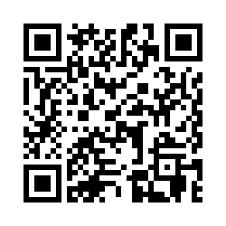
Please Share Your Feedback
Feedback QR Code
Notes:
https://usbe.az1.qualtrics.com/jfe/form/SV_6gIHktHNSURQKl8

