Slide 1


Purple Star Schools
Supporting Military Families in Utah

Slide 2
Utah Purple Star Schools Program
The Utah Purple Star Schools Program is a designation for Utah schools that excel in protecting the educational needs of students and families who are military-connected. This includes annual new school application opportunities and annual verification for existing schools.
Military-connected children move 6-9 times during their k-12 education (3x more than their civilian peers.)
Most of our military families in Utah don’t live on military bases.
National Guard or Reserve families also face challenges when deployed.
Currently, Utah does not have a statewide military student identifier, meaning many schools have no way of knowing which students are military-connected. Federal guidance specifically recommends collecting separate identifiers for: Active Duty families, National Guard families and Reserve families
Purple Star Schools supply resources and practices to support these students, ultimately supporting the entire school culture.

Slide 3
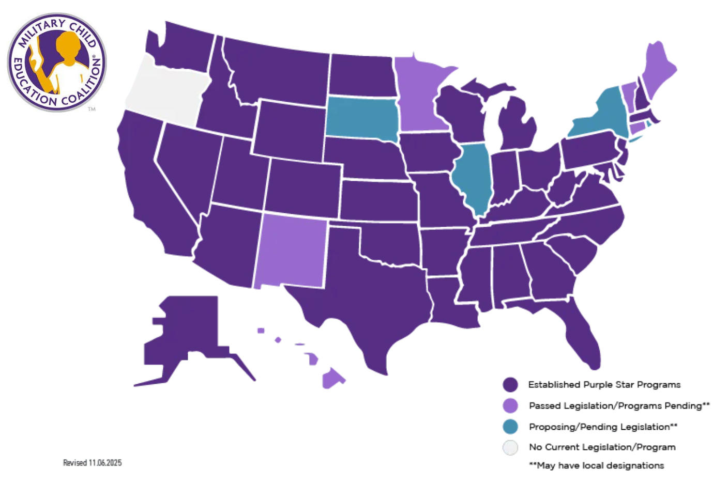

Slide 4
School Breakdown
177 total Purple Star Schools in 2026 SY
Alpine School District 45
Charter Schools 20
Davis School District 84
Jordan School District 1
Ogden School District 5
Tooele School District 1
Weber School District 21

Slide 5
New and Existing School Requirements
Designated staff point of contact
Web page with parent resources
Annual professional development for all staff
Military event or board resolution
Student-led transition program

Slide 6
Point of Contact
Designated staff point of contact for military students and families who acts as the primary link between a military family and the school; Must be a full-time school staff member.
Designate a staff member as a military liaison. The military liaison shall have all the following duties:
  Serve as the point of contact between the public/non-public school and military-connected students and the military-connected students' parents or guardians.
  Advise the school administrative team on appropriate supports available to military-connected students
  Assist in coordinating school programs relevant to military-connected students.

Slide 7
Website Best Practice
Website should include:
This site cannot be more than 3 clicks away
Welcome Statement
School Purple Star School Point of Contact - name, email, and phone.
New Student Orientation - first steps
Calendar with Specific Events
Military-connected Tailored Resources- which can be pulled from the
USBE website, MCEC and local area.
Optional -
HAFB School Liaison Office contact information.
Upcoming special dates, Events
Photos of previous events

Slide 8
Student-led Transition and Ongoing Support Team/Program
Student-led transition programs should include a student transition team coordinator.
Purpose: To establish a structured, student-led program that assists all military-connected students. The program provides peer-to-peer support for:
Newly Enrolled Students
Students experiencing shifts in their peer groups or academic tracks
Students facing parental absence due to military deployments, training, or
extended active-duty assignments.

Slide 9
Student-led Transition and Ongoing Support Team/Program continued….
Key Examples:
Student Transition and Ongoing Support Program/Team Coordinator (School staff member, PSS Coordinator)
  Oversight and delivery. Recruits student leads and helps them deliver an ongoing program.
  Collaborates with school staff, parents, and community partners for attendance, new students, student obstacles and challenges, and events. New student orientation, transition and ongoing support checklist packets.
  Student Leads/Ambassadors
  Guide new students through their first month of school or during parental separation.

Slide 10
Student-led Transition and Ongoing Support Team/Program continued…
d. Guide new students through their first month of school or during parental separation.
i. Meet new students at the front office, deliver a student-made welcome packet, provide a school tour, meet the student’s teacher(s), and ensure they have a designated peer group for lunch and school activities.
ii. Throughout the first week, continue to meet with the student, answer questions, and check on their well-being.
iii. Second week and on-going. Continue check-ins, introduce the student to clubs, sports, interest groups, after school/neighborhood activities, fully assisting them from new student to integrated peer.

Slide 11
Student-led Transition and Ongoing Support Team/Program continued…
e. Provide low-pressure, consistent peer support and check-ins for all students.
f. Organize and deliver events and programs that support the cohort.
2. Examples of national and local Student-Led Programs.
Student 2 Student (S2S) MCEC S2S
Anchored4Life Anchored4Life
Hope Squad Hope Squad

Slide 12
Examples of Military Events
One requirement for Utah Purple Schools is to host at least one military-connected event per school year, though we recommend that schools strive to support our students and families year-round.
Use this page to plan impact driven events, connect with local military commands, veteran service organizations, and promote patriotism amongst our next generation of leaders.
Fall Recommendations:
Prior to or during the standard back-to-school night or week, host a mini-mixer specifically for military-connected families. Partner with local military command, local community non-profits, and veteran service organizations.
  Provide school specific resources, student led peer team, handouts and information about local, state, and national military-connected student and family resources.
School faculty and Staff training
November
Invite parents, local military commands, veterans
  Veterans day assembly (local military members, parents, family members)
  Wall of Honor (photos of parents, staff, family members of training, deployments)
  Tribute of Heroes
  Breakfast, Donuts with

Slide 13
Examples of Military Events continued…
Spring
January/February Winter Warm-up Social
  A low pressure social event specifically targeting families with a parent away on training, deployment, or on active duty. Could be a hot coco mixer. The student led peer team could lead games with students while parents connect.
April
Month of the Military Child and Purple Up Day
  April is the most significant month for Purple Star Schools. Purple Up Day, which is typically the 15th celebrates the resilience of military kids.
    Encourage the entire student body and staff to wear purple
    Have an assembly recognizing military-connected students, inviting parents to participate. Invite a military member, parent, community member to speak to the student body about resilience.
    Have the student-led peer team place purple ribbons on the classrooms, desks, lockers of the military-connected students.

Slide 14
Examples of Military Events continued…
End of School Year
Departure, graduation social, giving a meaningful send-off,
  Host a lunch or after school social, provide students with a departure packet that includes a school pennant or a memory book signed by classmates and teachers.
  Create a Utah and local town “passport” booklet for departing students.
Graduation
  Provide military-connected graduates with a special Purple Cord to wear over their cap and gown during the ceremony and recognize them.
  Host a Senior Sunrise Breakfast

Slide 15
Professional Development
Purple Star Schools must provide professional development annually for all school staff on special considerations for military students and families (the date, topic and presenter must be retained). Department of War School Liaison Program. These officers can do on-site training. People who can help provide formal training:
Matthew Mason | matthew.mason.9@us.af.mil | Statewide, HAFB
Janet Seachris | janet.seachris@us.af.mil | Statewide, HAFB
Francesca Suarez | fsuarez@dsdmail.net | Military Support Team in Davis School District.
Michael Miller | mmmiller@utah.gov | UDVMA
Kayle Smith | kaylesmith@utah.gov | UDVMA
Juliann Bernhard | juliann.bernhard.naf@army.mil | Arm, Dugway, Tooele
Alicia Tullis | atullis@tooeleschools.org | MST Tooele
Patricia Dominguez | dominguezp@ogdensd.org | Ogden School District Military Support
Larissa Archuleta | laarchuleta@wsd.net | Weber School District Military Support
Colleen Russell | corussell1@wsd.net | Weber School District Military Support

Slide 16
Military-Connected Student Support Team (optional)
Schools are encouraged to establish a small team if possible that meets periodically to discuss ways to support military-connected students and families. This team may be an existing committee (such as a behavior, counseling, school climate, or family engagement team) rather than creating a new committee.
Suggested Team Members
Include individuals who are most involved in supporting students, such as:
Purple Star School Point of Contact
Administrator
School counselor or social worker
Teacher representative
Parent of a military-connected student (when available)
Student representative (optional)
Military School Liaison or community partner (as available)

Slide 17
Military-Connected Student Support Team (optional) cont.
Responsibilities
The team should:
Identify military-connected students and consider ways to support successful school transitions.
Review school practices and identify opportunities to improve support for military-connected students and families.
Coordinate activities such as Month of the Military Child or Veterans Day recognition.
Share available military and community resources with students, families, and staff.
Encourage staff awareness of the unique experiences of military-connected students.
Help maintain the school's Purple Star designation.
Meetings
Meet at least twice each school year (or as needed).
Meetings may include:
Discussing student needs or transition supports.
Planning school recognition events.
Reviewing available resources.
Identifying one or two goals for the coming year.

Slide 18
Military-Connected Student Support Team (optional) cont.
Community Partnerships
When available, schools are encouraged to collaborate with:
Military School Liaisons
Utah Department of Veterans & Military Affairs
Military Child Education Coalition (MCEC)
Blue Star Families
Local military installations
Veteran Service Organizations
Community organizations that support military families
Resources
Provide staff and families with access to state and national military family resources, including:
Military Interstate Children's Compact Commission (MIC3)
Military Child Education Coalition (MCEC)
Military OneSource
Utah Military Interstate Children's Compact
Utah Department of Veterans & Military Affairs
Utah Parent Center
SafeUT
Military School Liaison Program Rvsd. 7/22/26

