Slide 1
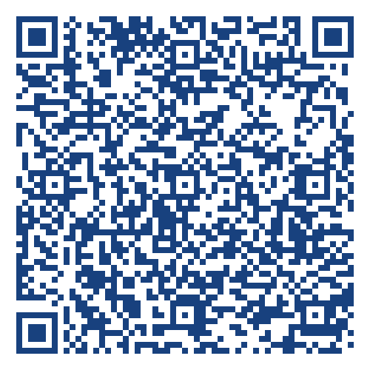

WIDA - Screeners
Assessing English Language Proficiency
Megan Lopez and Tracy Gooley
WIDA Assessment Specialists
https://tinyurl.com/2026Screener

Slide 2

Contact Information:
Megan Lopez, WIDA Assessment Specialist
megan.lopez@schools.utah.gov; 801-538-7723
Tracy Gooley, WIDA Special Education Assessment Specialist
tracy.gooley@schools.utah.gov; 801-538-7887

Slide 3
WIDA Screeners – New ADs
Learning Intention – New ADs will learn about WIDA Assessment requirements, particularly WIDA Screeners for identifying potential ELs in Utah . . .
Rationale – In order to ensure the AD's LEA is following the law as it relates to ELs . . .
Success Criteria -
  By accessing the two necessary WIDA accounts,
  By understanding where to access necessary resources, and
  By understanding the process of identifying ELs in Utah.

Slide 4
WIDA Acronyms
WIDA - Just WIDA . . .
EL - English Learner (legal)
ML - Multilingual Learner (preferred)
AD - Assessment Director
ALS - Alternative Language Services
ACCESS - Assessing Comprehension and Communication in English State-to-State . . . Just ACCESS
WIDA AMS (DRC) - Assessment Management System run by Data Recognition Corporation
LEA - Local Education Agency (you district or charter)
UTREx Pre-ID file - Utah eTranscript and Record Exchange for Pre-Identification file
ELP - English Language Proficiency

Slide 5
WIDA Tips:
As ADs, you will need to communicate with the following colleagues:
ALS/Title III– who will oversee WIDA assessments?
Technology Coordinator – Who will install student and test administrator technology and on what devices?
Administrators – When and where will testing be completed and ensure students have equitable opportunities to engage in testing?
Special Education Director – How will accommodations be communicated and WIDA Alternate ACCESS participants and administration be handled?
Resources:
USBE WIDA Website
USBE Title III Website
Utah WIDA Website
WIDA Accessibility and Accommodations Manual

Slide 6




WIDA Assessments:
WIDA Screener
WIDA ACCESS
Alternate ACCESS
• Screener Online 1-12 (WIDA AMS)
• Screener for Kindergarten and Alternate Screener K-12 (Available on WIDA Secure Portal)
Available year-round starting July 1, 2026
• ACCESS Online (WIDA AMS)
• Kindergarten ACCESS (Paper, ordered by USBE)
Testing Window:
January 5, 2027 to March 5, 2027
• Alternate ACCESS for ELs with the most significant cognitive disabilities (Paper, ordered by LEA).
Testing Window:
January 5, 2027 to March 5, 2027
Notes:
Screener
-Given to students the first time they enroll in Utah to determine if they are EL. Kindergarten is the new Screener for Kindergarten; however, K MODEL is an acceptable alternate. Alternate Screener is newer as well. Important: initial identification date and EL status must be marked correctly in your SIS system.
-Administer the Screener within 30 days of enrollment within the first month of school, and within 10 days of enrollment thereafter. (Students are eligible for EL services if they earn a score of 1-4.9 on Screener for grades K-12
ACCESS
-Given to students annually to measure their academic language in speaking, writing, listening, and reading in English until they reach proficiency – earning a proficiency level score of 5.0 or greater.
Alternate ACCESS
-Given to ELs with the most significant cognitive disabilities. (Paper ACCESS 2.0 is available for unique circumstances, such as ELs with disabilities or recently arrive ELs.)

Slide 7
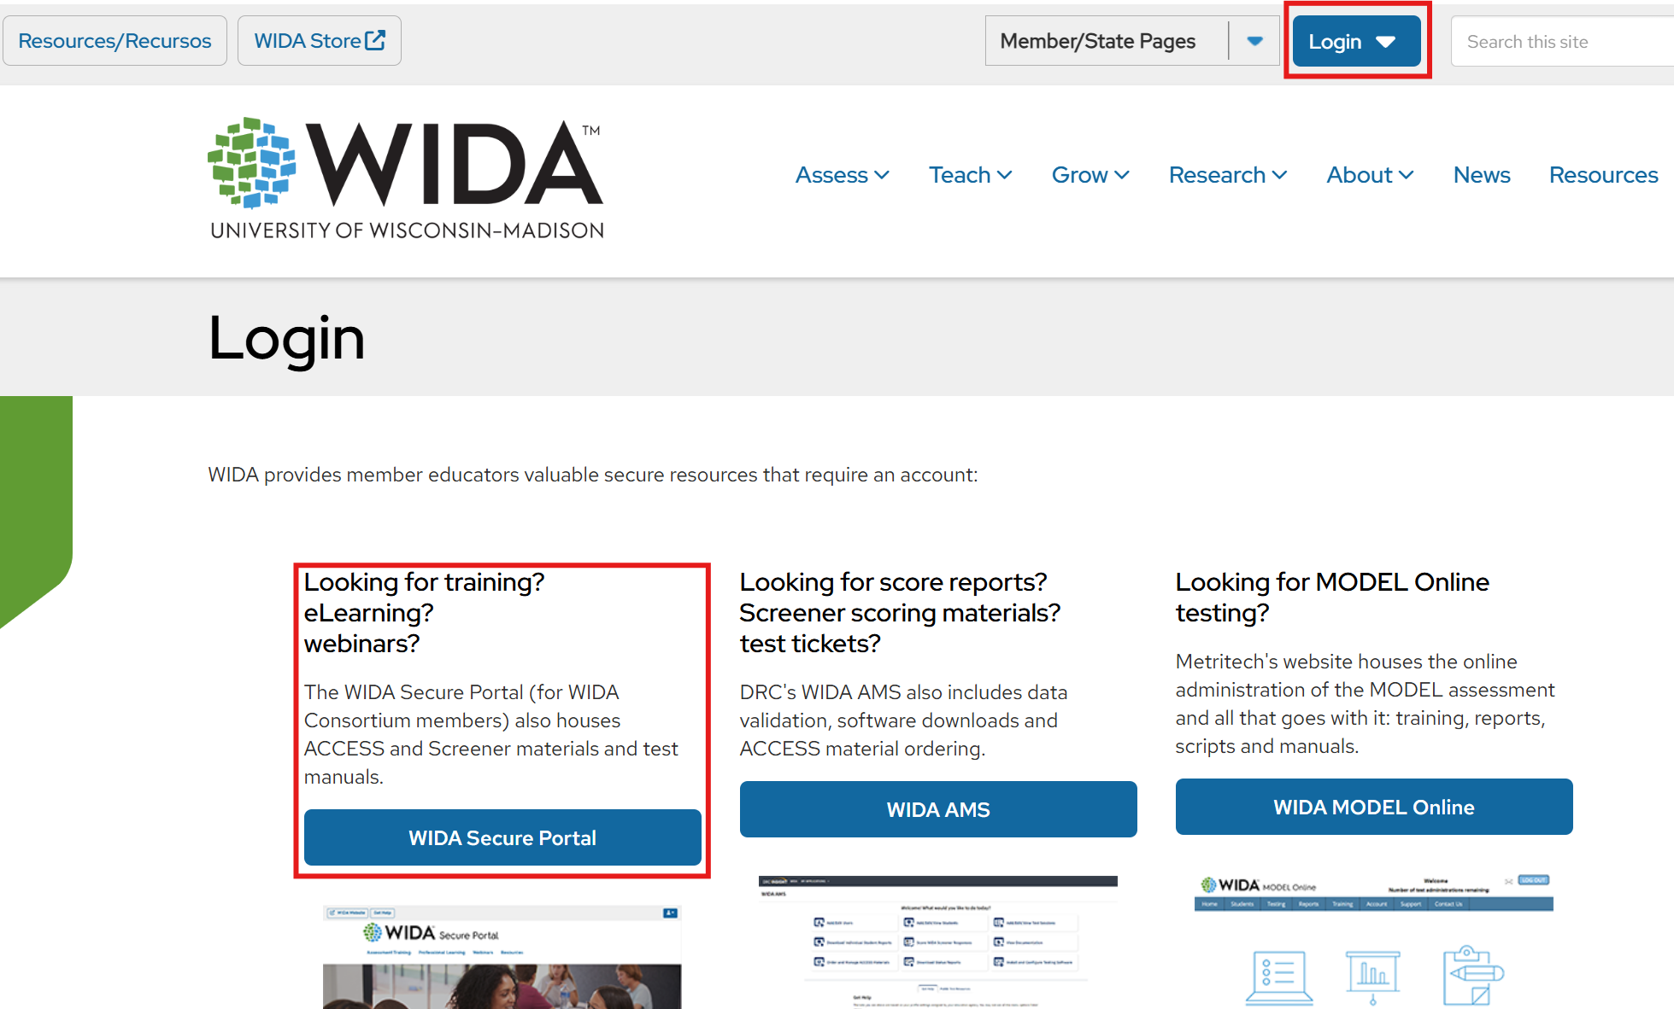
WIDA Secure Portal Accounts:
As new ADs, you will need a WIDA Secure Portal account
Contact Megan Lopez
Once you are set up as an AD, your responsibilities are:
  Create new accounts for your test administrators, technology coordinators, and educators
  Monitor who has completed the trainings for the assessments they will be administering
  Download Screener materials

Slide 8
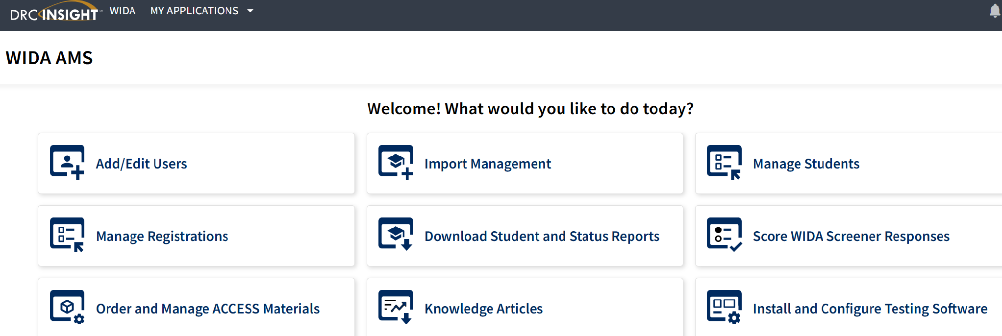
WIDA AMS Accounts:
As new ADs, you will need a WIDA AMS (DRC) account
Contact Megan Lopez
Once you are set up as an AD, your responsibilities are:
  Create new accounts for your test administrators, technology coordinators, and administrators
  Monitor student test completion,
  Order Braille and Alternate ACCESS materials
  Complete LEA Data Validation
  Retrieve test scores

Slide 9
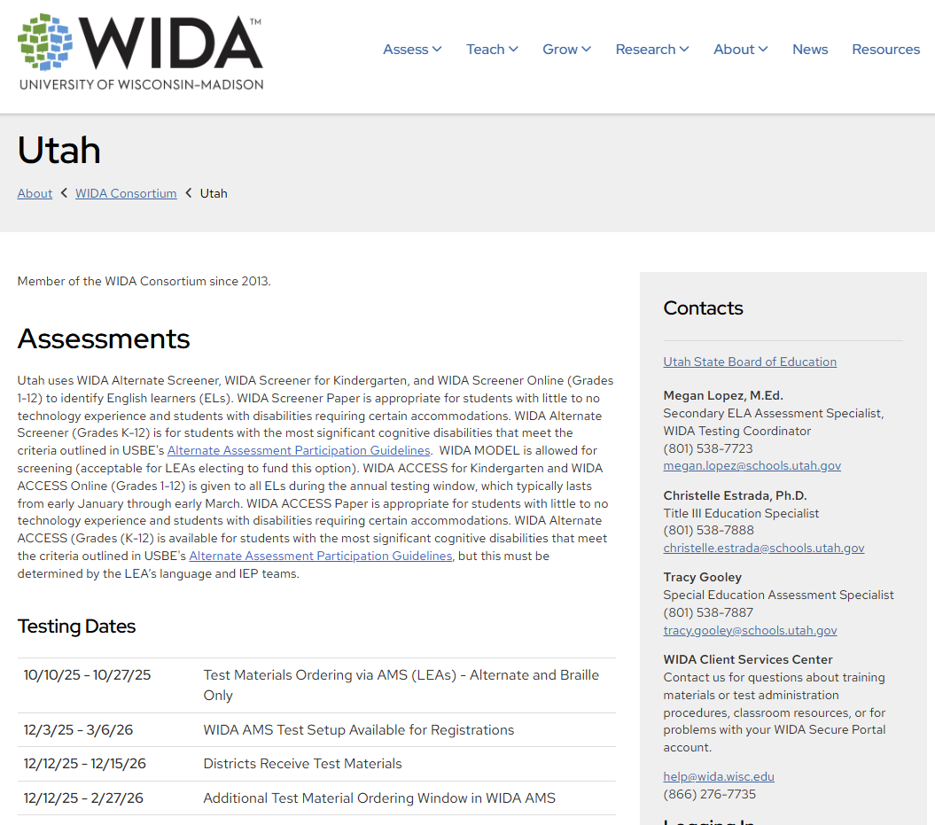
AD Responsibilities and Dates:
Become familiar with the WIDA Checklist, ID and Placement, and Manuals on the Utah WIDA Website.
Two-time UTREx Pre-ID Upload (late October 2026 and mid-December 2026)
ACCESS LEA Data Validation Two Weeks, April 2027
Distribute ACCESS Score Reports (Available Online late April 2027, Distribute May 2027)
Communicate training opportunities to educators and test administrators

Slide 10
WIDA Screeners
Free for all Utah LEAs through the WIDA Secure Portal and WIDA AMS
WIDA Screener is an English language proficiency assessment given to new students in grades K–12 to help educators identify whether students are English learners (ELs).
Assesses each of the four language domains: Listening, Speaking, Reading, Writing
Reports proficiency level scores for each language domain and for three composite scores: Oral Language, Literacy and Overall; score reports are produced at the individual student level only (not school, district or state)

Slide 11
Who Takes the WIDA Screeners?
USBE WIDA Assessment Guidance Resource
EL Identification Process:
  At registration, give Home Language Survey (HLS, go to Forms) in preferred language for parents/guardians to complete. The HLS can be electronic or paper
  If any of the FIRST three questions are answered with any language other than English, then the student must be screened. (Exception – If the student came from another Utah school and already has been identified as EL, they do not need to be screened)
  Assess the student using one of the WIDA Screeners (K-12)
  For students that qualify as EL and for language services, the Annual Notification Letter (go to Forms) must be sent to parents/guardians in the preferred language
  Update Student Information System (SIS)

Slide 12
WIDA Screener Options
WIDA Screener for Kindergarten:
  Paper-based, one-on-one test administration
  Materials are downloaded in the WIDA Secure Portal
WIDA Screener Online (grades 1-12):
  Grades 4-12 all online (including writing)
  Grades 1-3 writing domain is paper-based
  Group or single test administration
  Materials are downloaded in the WIDA Secure Portal and in WIDA AMS

Slide 13
Options Continued
WIDA Screener Paper (1-12):
  Request materials from USBE
  Paper-based, group or single test administration
  Only for students with little to no technology experience or for student's whose disability impedes access to the online option
WIDA Alternate Screener (K-12):
  Materials are downloaded in the WIDA Secure Portal
  Paper-based, one-on-one test administration
  For students with the most significant cognitive disabilities that meet the criteria outlined in the Alternate Assessment Participation Guidelines
WIDA MODEL (K-12):
  Optional to use as a screener, but the LEA must pay for the materials

Slide 14
Entrance Criteria
What qualifies for EL status and language services in Utah?
The WIDA Screener must be given to confirm EL Status; the HLS does not qualify a student as EL
Students who score a composite of ELP level 1–4.9 qualify as EL in Utah
Those who receive a composite score between 5.0 and 6.0 on the WIDA Screener do not qualify for English language services

Slide 15
Who can give the WIDA Screener?
Any LEA employee that has completed the Testing Ethics Training and the relevant WIDA Screener test administration training can give the assessment
Alternate Screener considerations:
  Have someone who is familiar with the student administer the alternate screener or be present with the person who is administering the alternate screener
  Consider the students form of communication and utilize it during administration (work with special education teacher)
  Consider the students reinforcement system and incorporate that during administration (work with special education teacher)

Slide 16
Broader Considerations
Utah WIDA Assessment Guidance Resource
Each state has a different criteria and process.
If a student lived in Utah, moved out of state, then returned to a Utah school during two different school years, they need to be screened.
Parents/guardians may elect to exclude their student out of services by indicating this choice on the Annual Notification Letter, which is kept with the student’s cumulative record. Parental/guardian exclusion of EL services does not opt students out of annual WIDA ACCESS assessment.

Slide 17
Training Opportunities 2026-2027:
Title ​ | Dates ​
13 Self-Paced Workshops available to all Utah Educators in the WIDA Secure Portal ​ | 9/1/26-8/31/27 ​
Section 1 - Actionable Approaches for Centering Newcomers | Webinars: ​9/23/26 and 9/30/26 Time: 3:30-5pm MT both days
Section 2 - Nurturing Speaking Growth | Webinars: 10/28/26 and 11/4/26 Time: 3:30-5pm MT both days ​
Section 3 - ​When Language and Disability Meet: Planning Instruction to Support Multilingual Learners Who Are Dually Identified | Webinars: 2/16/27 and 2/23/27 Time: 3-4:45pm MT both days
Register in Altitude Course ID 100055
Notes:
Altitude Link: https://www.usbealtitude.org/https://usbealtitude.org/sections?filter.courses.0=019f8b51-bcd7-7128-8d48-524dacd4d0a9&filter.styles=~&filter.registrationOpenNow=false&filter.inProgressNow=false&filter.activeOnly=false&search=&defaultFilter.Always=true

Slide 18
Training Opportunities 2026-2027:
Title ​ | Dates ​
Section 4 - ​Standards Aligned Instruction: Language, Literacy and Biliteracy Planning | In Person (SLC) : 3/16/27 Time: 8am-4pm MT
Section 5 - Collaboration Practices and Potentialities ​ | In Person (SLC) : 5/18/27 Time: 8am-4pm MT
Register in Altitude Course ID 100055

Slide 19
WIDA Screeners – New ADs
Learning Intention – New ADs will learn about WIDA Assessment requirements, particularly WIDA Screeners for identifying potential ELs in Utah . . .
Rationale – In order to ensure the AD's LEA is following the law as it relates to ELs . . .
Success Criteria -
  By accessing the two necessary WIDA accounts,
  By understanding where to access necessary resources, and
  By understanding the process of idetifying ELs in Utah.

Slide 20
Contact Information:
Megan Lopez, WIDA Assessment Specialist
megan.lopez@schools.utah.gov; 801-538-7723
Tracy Gooley, WIDA Special Education Assessment Specialist
tracy.gooley@schools.utah.gov; 801-538-7887

