Slide 1

WIDA
Assessing English Language Proficiency
Megan Lopez
Megan.lopez@schools.utah.gov
Tracy Gooley
Tracy.Gooley@schools.Utah.gov

Slide 2
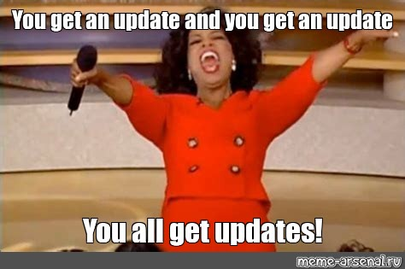
WIDA Website Updates
USBE’s WIDA website has been updated.
The EL Assessment Guidance has also been updated.

Slide 3
LEA Updates
Do you have new staff needing district/LEA level accounts?
Please email Megan Lopez megan.lopez@schools.utah.gov
Shipping address changed?
Please email Maureen Rushing maureen.rushing@schools.utah.gov

Slide 4
WIDA Screener 2026-2027 Information
All materials are free in the WIDA Secure Portal and/or WIDA AMS
  Kindergarten Screener and Alternate Screener (K-12) in WIDA Secure Portal
  Online Screener (1-12) in WIDA AMS
    Online Writing for grades 1-3 in WIDA Secure Portal
Contact Megan Lopez for Paper Screener materials

Slide 5
WIDA Screener 2026-2027 Information
Updated WIDA Screener 2026 Training
  For New ADs and ADs needing a refresher
  Link to Recording
All test administrators must complete test administration trainings annually. Trainings available in the WIDA Secure Portal.
Students must be administered Screener within 30 calendar days of enrollment within the first month of school, and within 10 school days of enrollment thereafter.
Annual Notification Letter (forms tab)

Slide 6
WIDA ACCESS 2026-2027 Information
Data Gateway 2026 ACCESS Reports Available
Updated WIDA ACCESS 2026 Training
  For New ADs/ALS and ADs/ALS needing a refresher
  Link to Recording

Slide 7
WIDA ACCESS 2026-2027 Information
2026-2027 ACCESS Dates are now available!
  10/12/26 - 10/27/26: LEA Test Materials Ordering via AMS - Alternate and Braille Only
  10/30/26: USBE Loads 1st Pre-ID File into WIDA AMS
    LEAs, ensure your SIS is updated
  12/2/26 - 3/5/27: WIDA AMS Test Setup Available for Registrations
  12/10/26: USBE Loads 2nd Pre-ID File into WIDA AMS
    LEAs, ensure your SIS is updated
  12/14/26 - 12/15/26: LEAs Receive Test Materials
  1/5/27 - 3/5/27: ACCESS Test Window

Slide 8
ESSA Amendment Approved!
Updated ELP Indicator per Utah’s 2026 ESSA Plan Approved
Alternate ACCESS Proficiency and Adequate Progress Targets (APT) will be calculated in the English Language Proficiency metrics for the 2025-2026 reporting year.
General ACCESS Adequate Progress Targets (APT) have been updated and will be applied upon the WIDA data load.

Slide 9
ESSA Amendment Approved!
Alternate ACCESS Students Can be Exited!
The EL Assessment Guidance has directions for exiting students taking Alternate ACCESS.
New Exit Letters to Parents have been updated, translated, and posted to USBE’s Title III website.

Slide 10
ESSA Alternate Next Steps
Schools can begin scheduling the required teacher-student-parent conferences, within 30 school days of this notification, to discuss the necessary support for the student to make continuous progress in all content areas without language services program.
Update your SIS
  mark the student as fluent
  enter the monitoring entry date
  students should be placed in monitoring for four years.

Slide 11
2026-2027 WIDA Trainings
2026-2027 WIDA Trainings Now Available for Registration
Register in Altitude Course ID 100055 titled “2026-2027 WIDA Trainings.” Five Webinars and/or In-Person trainings will be available for the 2026-2027 school year. Please share with relevant colleagues. Click the provided link for a list of the available trainings and flyers with details that can be shared with your LEA.
New self-paced courses available September 1, 2026 in the WIDA Secure Portal.

Slide 12
Upcoming Free Webinars
WIDA Screener Online and Paper - August 4, 2026, 12:00pm - 1:00pm MT. This webinar discusses the purpose and design of the assessment, administering and scoring the assessment, and understanding score reports. This webinar is not a replacement for certification training course.
WIDA ACCESS for New Test Administrators - September 8, 2026, 12:00pm - 1:00pm MT. This webinar provides information on finding and enrolling in the training, navigating the WIDA Secure Portal, and finding resources about testing. We will also discuss recertification and state checklists to know what tasks to complete.
WIDA ACCESS for New District Test Coordinators - September 10, 2026, 12:00pm - 1:00pm MT. This webinar provides information how to create WIDA Secure Portal and WIDA AMS accounts, review training in the Secure Portal, and find state-specific resources surrounding WIDA ACCESS testing. We will also be going over the different options and permissions in both WIDA AMS and the WIDA Secure Portal.
Ordering WIDA ACCESS Materials in WIDA AMS - September 22, 2026, 12:00pm - 1:00pm MT. This webinar provides an overview of ordering test materials for WIDA ACCESS, monitoring order status, confirming shipping address, and troubleshooting ordering materials.
Past WIDA Webinar Recordings - always available

Slide 13
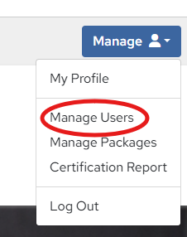
WIDA: Did you Know?
Every educator in Utah can have a WIDA Secure Portal account.
There are 13 FREE asynchronous Canvas courses available starting September 1, 2026.
Contact WIDA Client Services for
bulk upload.
help@wida.wisc.edu | 1-866-276-7735

Slide 14

Contact Information and Websites:
Megan Lopez
WIDA Assessment Specialist
megan.lopez@schools.utah.gov; 801-538-7723
Tracy Gooley
WIDA Special Education Assessment Specialist
tracy.gooley@schools.utah.gov; 801-538-7887
USBE WIDA Assessment Website
WIDA’s Utah Website

